Slide 1

SMART AGRICULTURE SYSTEM BASED ON IoT
Internship at SmartInternz

Slide 2
PROJECT DETAILS-
Application ID - SPS_APL_20200004106
Project ID - SPS_PRO_101
Name – Snehasish Pradhan
Email ID – sailofthoughts@gmail.com

Slide 3
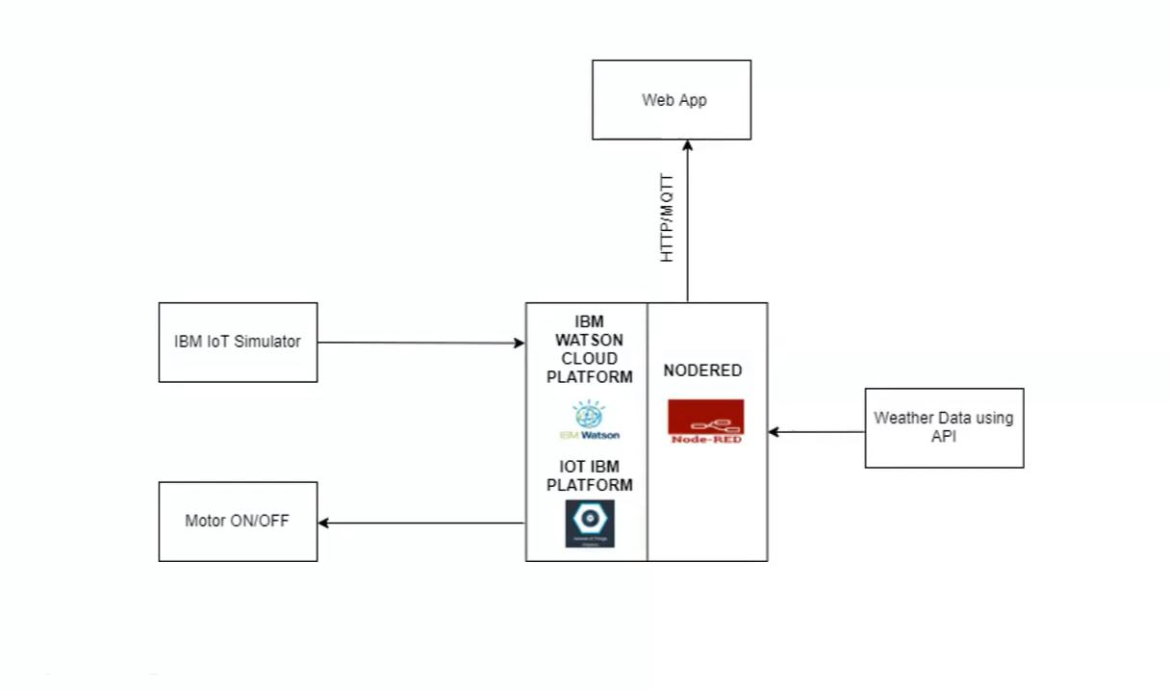
Project Summary-
The project propose to create a novel smart IOT based agriculture system which will assist farmers in getting live data (Temperature, soil moisture, humidity) for efficient environment monitoring which will enable them to do smart farming and increase their overall yield and quality of products.
Project Requirements-
1. Coding platform
2. IBM Watson and IBM Cloud
3. Node-RED
4. IoT IBM platform
5. Openweather API
6. Python Programming
7. Simulated sensors

Slide 4
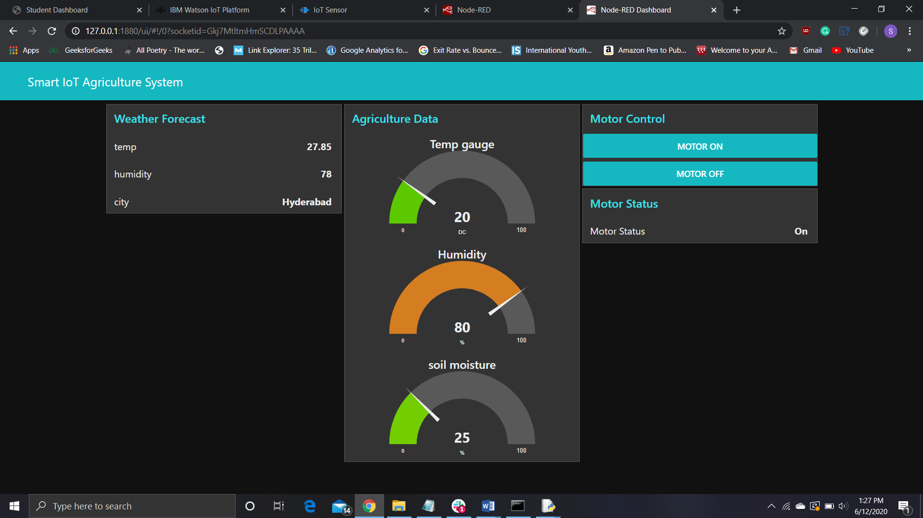

Slide 5
CONCLUSION-
An IoT Web Application is built successfully for smart agricultural system using Watson IoT platform, Watson simulator, IBM cloud and Node-RED. This will assist farmers in getting live data (Temperature, soil moisture, humidity) for efficient environment monitoring which will enable them to do smart farming and increase their overall yield and quality of products.
This app intends to provide farmers a mobile app using which he can monitor the temperature, humidity and soil moisture parameters along with weather forecasting details. Based on all the parameters he can water his crop by controlling the motors using the web application. Even if the farmer is not present near his crop he can water his crop by controlling the motors using the mobile application from anywhere.
FUTURE SCOPE-
With the growing population of the nation, the demand for food also increases and to satisfy all the needs, it is important that agriculture activities are carried out in most accurate and efficient manner. Bringing in IOT technology over here can assist us greatly with automated farming activities, maintaining the quality of the products and reducing the extravagant use resources like electricity and water.

